Slide 1
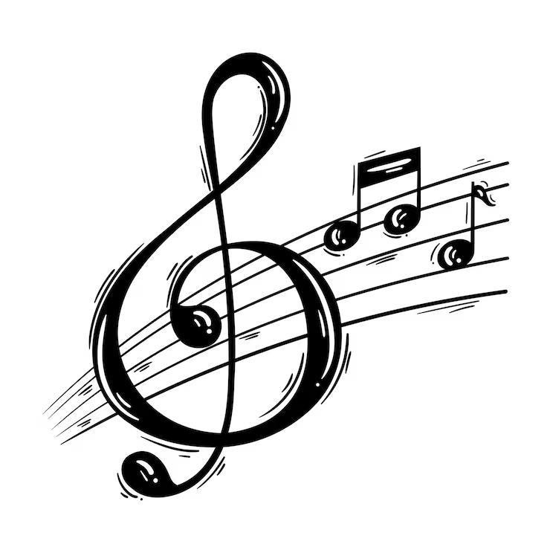
M
Personalized music discovery
🎵 Introduction to is a digital platform that allows users to listen to music online without downloading audio files. It provides instant access to millions of songs, albums, and playlists from various artists and genres through the internet. Users can stream music on-demand, create personalized playlists, discover new tracks, and enjoy high-quality audio from anywhere, at any time. Modern music streaming apps like Spotify, Apple Music, YouTube Music, and Gaana have transformed how people consume music by combining technology, user preferences, and AI-driven recommendations. These apps use cloud storage, data analytics, and machine learning to offer customized listening experiences based on the user’s mood, taste, and listening history.In essence, a music streaming app eliminates the need for physical storage, enhances accessibility, and revolutionizes the way users interact with music in the digital age.

Slide 2

roblem statement
Problem statement
In today’s digital era, users have access to millions of songs across various streaming platforms. However, discovering music that truly aligns with an individual’s unique taste, mood, and listening habits remains a significant challenge. Existing recommendation systems often rely heavily on general popularity trends or limited user data, resulting in repetitive or irrelevant suggestions.
There is a need for an intelligent and adaptive music discovery system that can analyze user preferences, behavior, and contextual factors (such as mood, time of day, and activity) to deliver highly personalized music recommendations. Such a system should enhance user engagement, satisfaction, and the overall listening experience by continuously learning and evolving with the user’s musical journey.

Slide 3
🎧 Research & User Understanding
1. Purpose of Research
The main goal of user research is to understand how people listen to music, what features they value most in a music streaming service, and what pain points they face with existing platforms. This helps in designing an app that meets real user needs and provides an enjoyable listening experience.
2. Research Methods
To gather insights, both qualitative and quantitative research methods can be used:
Surveys & Questionnaires: To collect user preferences about genres, listening frequency, and favorite features.
Interviews: To gain deeper understanding of user motivations and frustrations.
Competitor Analysis: Studying existing apps like Spotify, YouTube Music, and Apple Music to identify gaps and opportunities.
Usability Testing: Observing how users interact with music interfaces to improve navigation and flow.

Slide 4

3. Key Findings
From the research, common trends and needs include:
Users want easy access to music and personalized recommendations.
Offline listening and ad-free experience are highly valued.
Simple, attractive UI and fast load times increase satisfaction.
Many users enjoy social sharing features like playlists and song recommendations.
Young users (18–30) prefer AI-based mood playlists and cross-device sync.
4 . User Personas
Example Persona:
Name: Riya Sharma
Age: 21
Occupation: Student
Music Habits: Listens daily while studying and traveling.
Pain Points: Too many ads, confusing navigation, repetitive recommendations.
Goals: Wants quick song access, mood-based playlists, and smooth playback.

Slide 5
5. Insights & Design Implications
Focus on personalization and user control over playlists.
Ensure clean, intuitive UI/UX with minimal steps to play a song.
Provide seamless performance, even on low-speed connections.
Offer freemium model – free version with ads and premium for ad-free, offline use.
🎵 Information Architecture (IA) for Music Streaming App
Information Architecture (IA) defines how the content and features are structured, organized, and connected so users can easily navigate and find what they need.
1.Main Sections (Top-Level Structure)
Home
  Personalized playlists (e.g., "Made for You", "Recently Played")
  Trending songs/albums
  Recommended artists/genres

Slide 6
Search
Filters (genre, mood, language)
Suggested searches
Library / Your Music
Playlists
Search bar (songs, artists, albums, podcasts)
Liked songs
Albums
Artists
Downloads
Now Playing
Song info (title, artist, album art)
Controls (play/pause, next/previous, shuffle/repeat)
Lyrics
Queue list
Profile / Settings
Account details
Subscription plan
Preferences (language, theme)
App settings

Slide 7
2. User Flow Example
User Goal: Listen to a favorite artist
Open app → Home Screen
Tap Search → Type artist name
Select artist profile → View top songs/albums
Choose song → Now Playing Screen
Add to playlist or download
🧩 Wireframing (Low-Fidelity Sketch)
Wireframes are simple blueprints that show layout and functionality — not visual design.
Here’s how you can structure main screens:
1. Home Screen
Sections:
Top bar → Logo, Profile icon
Search bar
Carousel → Featured playlists or artists
Horizontal lists → “Recently Played”, “For You”, “New Releases”

Slide 8
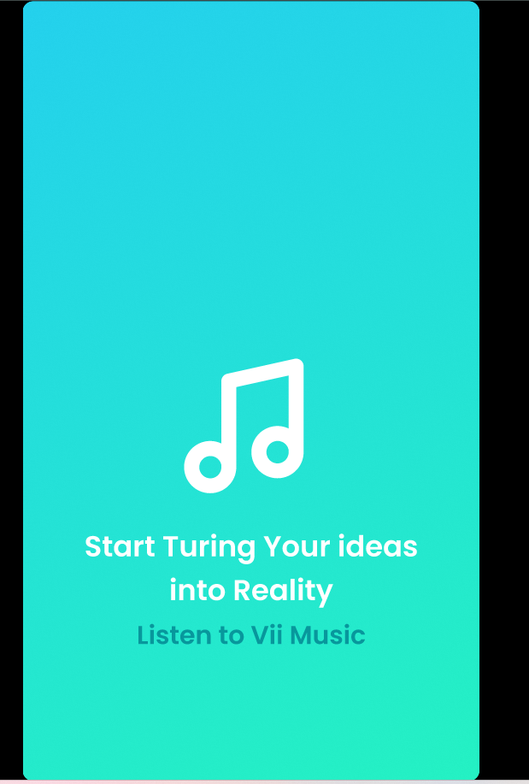

Slide 9
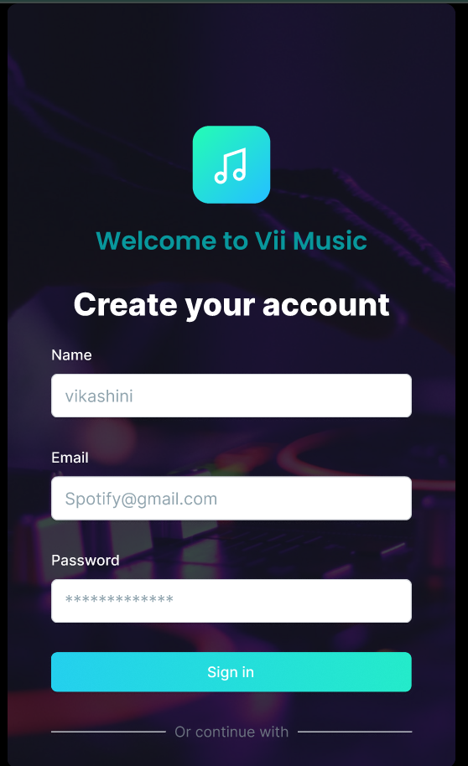

Slide 10
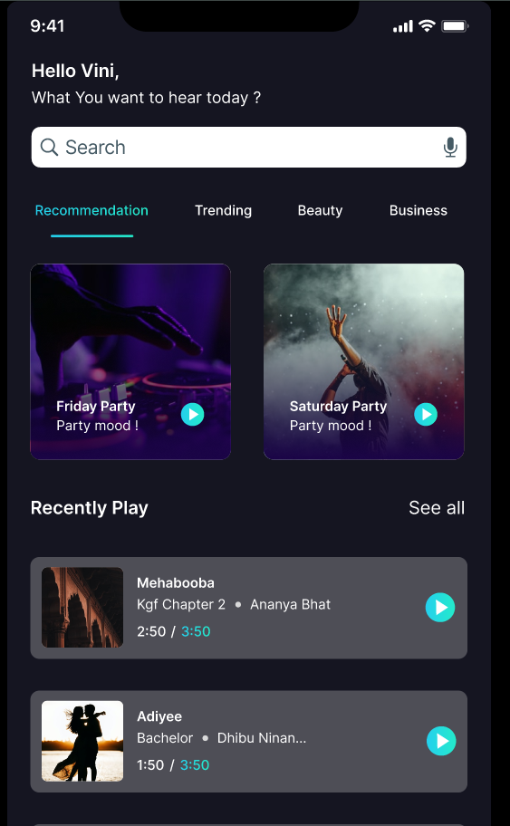

Slide 11
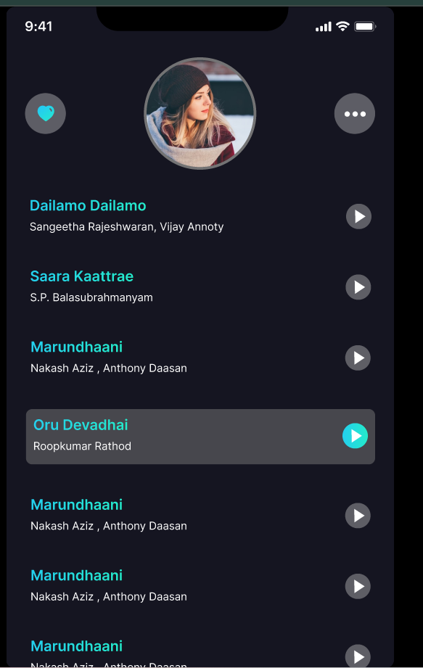

Slide 12
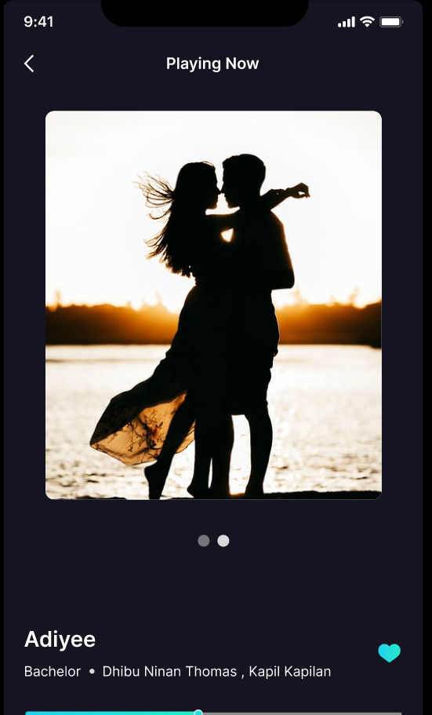

Slide 13
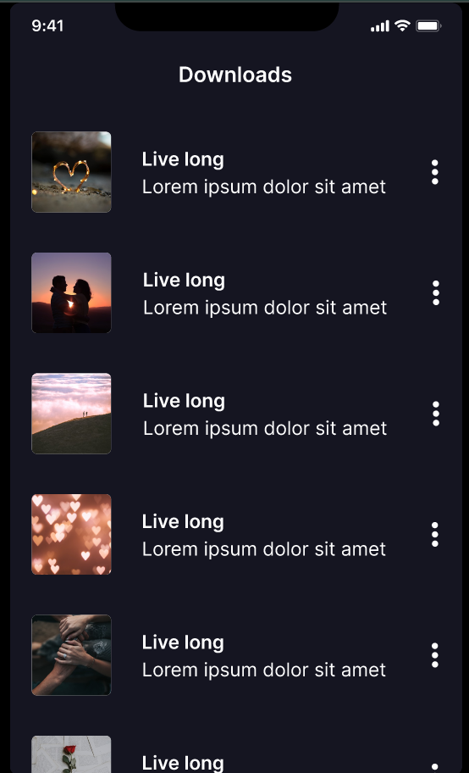

Slide 14
2. Search Screen
Layout:
Top → Search input field
Categories grid → Genres, Moods, Podcasts
Recent searches
Suggested artists or playlists
3. Library Screen
Tabs:
Playlists | Songs | Albums | Artists | Downloads
Each shows a scrollable list with album art and title.
4. Now Playing Screen
Elements:
Album art (center)
Song title + artist
Progress bar
Controls → Play, Pause, Skip, Shuffle, Repeat
Lyrics (expandable)
Add to playlist / Like button

Slide 15
5. Profile / Settings
Sections:
User name + avatar
Subscription info
Preferences (Dark mode, Notifications)
Log out button
🎨 1. Visual Design (UI Design Phase)
Visual design defines how your app looks — the colors, typography, icons, images, and overall mood.
A. Design Style & Theme
Goal: Create a mood that matches your app’s identity.
Example themes for music apps:
🎧 Dark Mode (Popular) → Black, dark gray backgrounds with vibrant accent colors (Spotify-style).
🌅 Vibrant Theme → Gradient backgrounds (e.g., purple → pink, or blue → cyan).
🩵 Minimal Th→ Clean white background with pastel accents.

Slide 16
Example Color Palette:
Purpose | Color Example
Background | #121212 (dark gray)
Primary Accent | #1DB954 (green)
Secondary Accent | #FF4B4B (red for likes)
Text | #FFFFFF (white)
Inactive Icons | #B3B3B3
B. Typography
Font Family: Use modern sans-serif fonts like Poppins, Inter, or Roboto.
Font Hierarchy:
  Title: 20–24px, bold
  Subtitle: 16px, medium
  Body: 14px, regular

Slide 17
C. UI Components
Buttons: Rounded corners, soft shadows
Cards: For playlists and albums with hover effects
Icons: Use vector icons (Lucide / Material icons)
Tabs & Navigation Bar: Minimal icons with labels like Home, Search, Library, Profile
D. Imagery
High-quality album art & artist photos
Background blur or gradient overlays to highlight album covers
Subtle animations for transitions (e.g., play button pulse)
E. Accessibility
Contrast ratio > 4.5:1
Font size scalable
Color-blind friendly accents

Slide 18
⚡ 2. Prototyping (Interactive Phase)
Prototyping makes your app clickable — users can experience the flow before development.
A. Tools to Use
Figma / Adobe XD / ProtoPie / InVision
  Figma is best for creating both visual UI and interactive prototypes in one place.
B. Prototype Flow Example
Start Screen → Home
  Tap on Trending Playlist → Opens Playlist Detail Screen
Playlist Detail → Song List
  Tap Play → Opens Now Playing Screen
Now Playing → Swipe Up
  Shows lyrics or queue
Tap Heart Icon → Adds song to Liked Songs
C. Animation Ideas
Microinteractions:
  Heart fills when you like a song
  Smooth transitions between album covers
  Sliding progress bar while playing music
Page transitions: Fade, slide-in

Slide 19
🎧 Usability & Interaction Design – Music Streaming App
🧩 1. Usability Design
Usability focuses on how easily and efficiently users can use the app — making it intuitive, fast, and satisfying.
A. Usability Goals
Goal | Description
Learnability | New users should quickly understand how to use the app (e.g., play a song, search, create a playlist).
Efficiency | Users can perform actions in fewer steps (e.g., one-tap play).
Memorability | Returning users easily remember navigation and gestures.
Error Prevention | The interface prevents mistakes (e.g., confirmation before deleting playlists).
Satisfaction | The overall experience feels smooth, fun, and rewarding.

Slide 20
B. Usability Principles
Consistency – Same icons, buttons, and layout across screens.
Feedback – Immediate visual or audio response (e.g., heart icon fills when liked).
Visibility of System Status – Show buffering, download progress, or “Now Playing.”
Minimalist Design – No clutter; focus on content and controls.
Accessibility – Large buttons, contrast-friendly colors, voice commands support.
C. Example: Usability Flow
Task: User wants to play a favorite song
Open app → Home
Tap Search → Type song/artist
Select result → Play
Add to Playlist → Confirmation message “Added Successfully”
This flow should take no more than 3–4 interactions.
🖱️ 2. Interaction Design (IxD)
Interaction Design defines how users interact with the interface — through gestures, animations, and feedback.

Slide 21
A. Core Interactions
Action | Interaction Type | Example
Play / Pause | Tap | Play icon changes to pause
Next / Previous | Swipe | Song changes with animation
Like / Favorite | Tap heart | Heart fills red
Search | Type / Voice input | Suggestions appear instantly
Add to Playlist | Long press / Menu | Modal popup appears
View Lyrics | Swipe up | Lyrics panel expands
B. Gestures
Swipe left/right → Skip songs
Swipe up → Expand Now Playing view
Drag → Adjust progress bar
Tap → Play/pause or open menu

Slide 22
C. Microinteractions & Feedback
Microinteractions make the app feel alive ✨
Button Ripple Effect – Visual feedback on tap.
Album Art Rotation – While music plays.
Animated Progress Bar – Smooth timeline motion.
Heart Animation – Expands or glows when liked.
Haptic Feedback – Soft vibration when actions complete.
D. Example: “Now Playing” Screen Interaction Flow
Tap song → Now Playing opens with smooth slide-up animation.
Album art rotates while song plays.
Swipe up → Lyrics fade in.
Tap heart → “Liked” animation appears.
Swipe down → Return to Home.

Slide 23
🔍 3. Usability Testing
After designing interactions, test with real users to check ease of use.
Test Type | Description | Example
Task Testing | Observe users completing tasks | “Find and play a song.”
A/B Testing | Compare two UI designs | Button styles or layout
Think-Aloud | Ask users to explain thoughts while using app | Detect confusion points
Heuristic Evaluation | Expert checks based on usability principles | Consistency, feedback, error prevention
Metrics to Measure
Task completion time
Clicks/taps per action
Error rate
User satisfaction score

Slide 24
🎯 4. Deliverables
At the end of this stage, you should have:
✅ Interactive Prototype (Figma, Adobe XD, or Framer)
✅ User Flow Diagram
✅ Usability Test Report
✅ Refined Interaction Design
🎤 Presentation & Documentation – Music Streaming App
This final stage showcases your design process, outcomes, and usability insights clearly and attractively.
It’s usually the phase where you present your project (e.g., in class or a final report).
🧩 1. Purpose of This Phase
To present your entire design journey — from research to prototype.
To document all findings, designs, and feedback in a structured, visual, and easy-to-understand way.
To communicate your app’s purpose, features, and user experience effectively.
🖥️ 2. Presentation (Slides / Live Demo)
Your presentation should tell a story — problem → solution → result.
Use clear visuals, screenshots, and short bullet points.

Slide 25
🖥️ 2. Presentation (Slides / Live Demo)
Your presentation should tell a story — problem → solution → result.
Use clear visuals, screenshots, and short bullet points.
🪄 Suggested Slide Structure
Slide No. | Title | Content Overview
1 | Title Slide | Project Name, Team Members, Logo
2 | Introduction | What is the Music Streaming App? Purpose and goals
3 | Problem Statement | What user problem are you solving (e.g., personalized music experience, simple UI)
4 | Research & Insights | User needs, pain points, competitor analysis (Spotify, Apple Music, etc.)
5 | Information Architecture | Structure of app (Home, Search, Library, Now Playing, Profile)

Slide 26
6 | Wireframes | Low-fidelity sketches or layout structure
7 | Visual Design | Color palette, typography, icons, and high-fidelity mockups
9 | Prototyping | Figma/Adobe XD screenshots, clickable demo flow
8 | Usability & Interaction Design | Gestures, feedback, microinteractions, accessibility features
10 | Testing & Feedback | Usability testing summary, improvements made
11 | Final Output / Screens | Show key app screens (Home, Search, Now Playing, Profile)
12 | Conclusion & Future Scope | Next steps (e.g., adding podcasts, AI recommendations)
13 | Q&A / Thank You | Contact info or credits

Slide 27
💡 Tips for an Engaging Presentation
Use minimal text + strong visuals.
Maintain consistent color and typography (same as your app theme).
Add transitions or simple animations between slides.
If possible, do a live demo of your prototype (Figma/Adobe XD).
Keep it under 10–12 minutes.
📄 3. Documentation (Project Report)
Your documentation should describe every stage of your design and development process in detail.
🧾 Suggested Report Format
1. Cover Page
Project Title, Team Name, Members, Institution, Date
2. Abstract / Summary
Short overview of your app and objectives.
3. Introduction
Purpose and goals of your music streaming app.
4. Problem Statement
What issues users face in current music apps.

Slide 28
5. Research & User Analysis
Target audience
User personas
Competitor comparison
6. Information Architecture
Sitemap or structure diagram
7. Wireframing
Low-fidelity sketches and flow explanation
8. Visual Design & Prototyping
Color scheme, typography, UI elements
Screenshots of prototype
9. Usability & Interaction Design
Gestures, feedback mechanisms, and user testing summary
10. Tools Used
Figma, FigJam, Adobe XD, Photoshop, etc.
11. Result / Outcome
Screens and mockups of final design
How usability improved after testing
12. Conclusion & Future Enhancements
Summary and next-step ideas

Slide 29
🧰 Tools for Presentation & Documentation
Presentation: PowerPoint / Google Slides / Canva
Documentation: MS Word / Google Docs / PDF Export
Design Tools: Figma / Adobe XD / FigJam / Photoshop
📦 Final Deliverables
✅ Presentation slides
✅ Design report / documentation (PDF or Word)
✅ Interactive prototype (Figma/Adobe XD link)
✅ Supporting visuals (wireframes, IA, icons, color palette)

Slide 30
Conclusion
Personalised music discovery aims to transform the way users interact with digital music platforms by delivering recommendations that truly resonate with their individual tastes and emotions. By leveraging user data, listening patterns, and contextual factors, an intelligent recommendation system can provide a seamless and engaging music experience.
Such a system not only enhances user satisfaction but also strengthens loyalty and exploration within the platform. Ultimately, personalised music discovery bridges the gap between technology and human emotion—helping every listener find the right music at the right moment.

